Slide 1
Building Software Systems for Image-Guided Robot-Assisted Interventions with SlicerROS2
04/19/2023

Slide 2
Overview
Part 1: AI segmentation from tracked ultrasound images
Part 2: Intro to SlicerROS2
Part 3: Image registration and path planning in Slicer

Slide 3
Part 1: AI segmentation from tracked ultrasound images

Slide 4
How to capture tracked ultrasound in 3D Slicer
Make sure your ultrasound and tracker are PLUS compatible by checking here for a list of supported devices: https://plustoolkit.github.io/features
For this demo we used an Aurora tracker and a Clarius US probe
For more information, check out the SlicerIGT tutorials here: https://www.slicerigt.org/wp/user-tutorial/
3D Slicer
Tracker
PLUS server
OpenIGTLinkIF
US probe

Slide 5
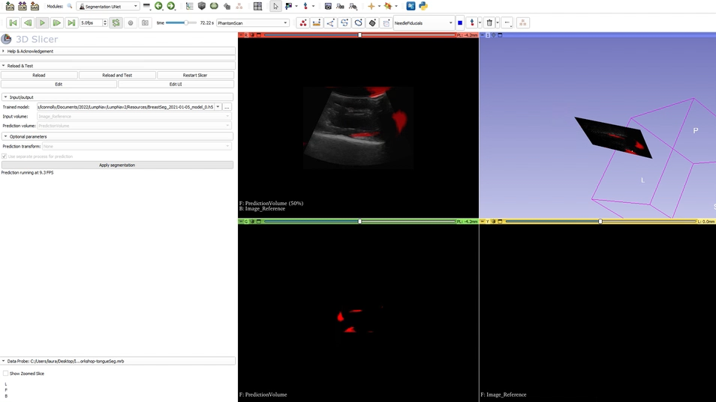
AI segmentation in Slicer

Slide 6
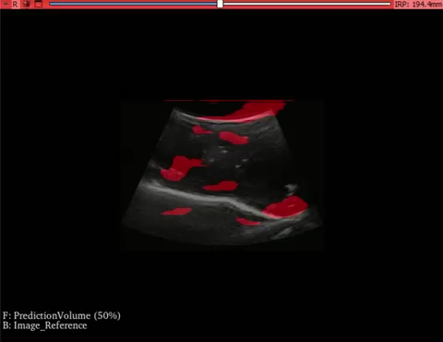

Slide 7
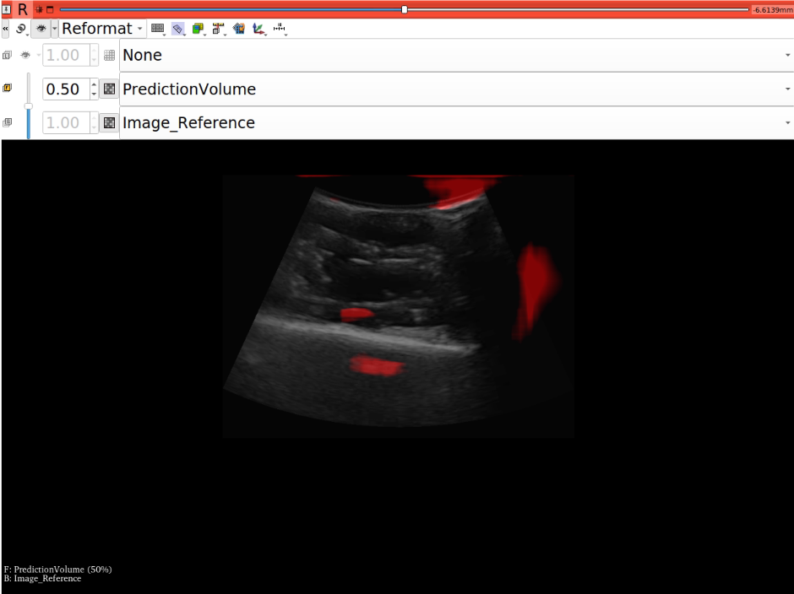
AI tumor segmentation from ultrasound
Load the scene “ISMRWorkshop-tongueSeg.mrb”
Update your slice views (see below):

Slide 8
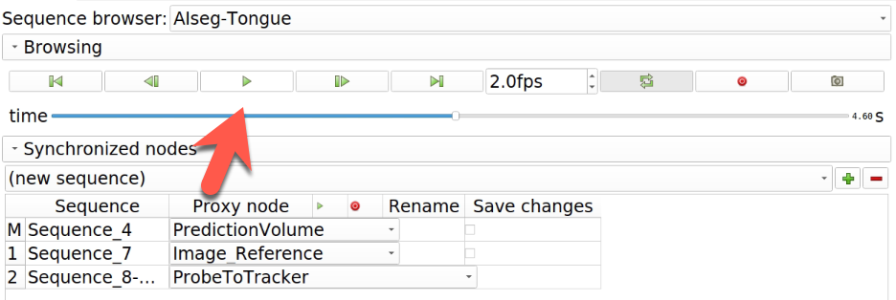
Playback the tracked US data and live prediction using the Sequences module
Ultrasound image with UNet prediction overlay
Tracked data (this should be moving when the sequence is playing)
Prediction only
References: https://www.youtube.com/watch?v=WyscpAee3vw – Tamas Ungi

Slide 9
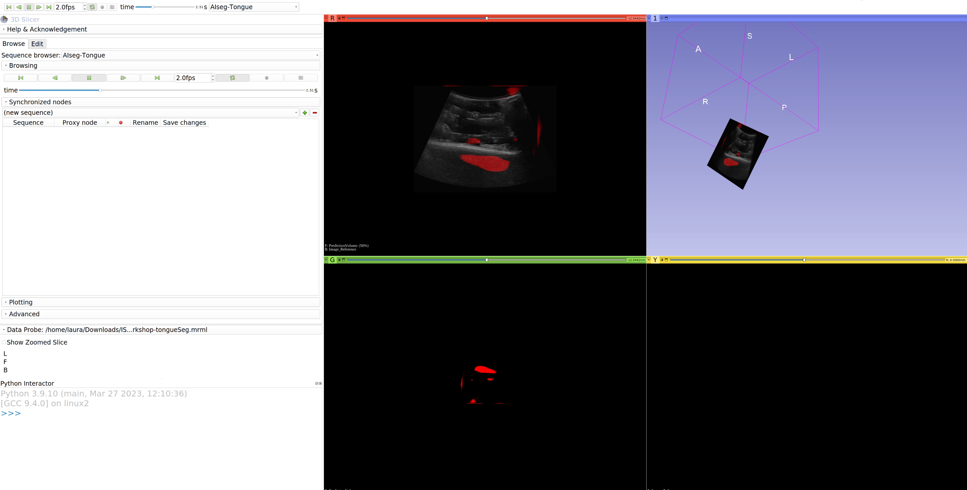
Ultrasound image with UNet prediction overlay
Tracked data (this should be moving when the sequence is playing)
Prediction only

Slide 10
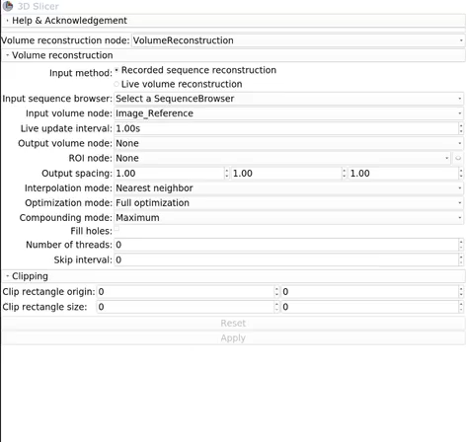
Switch to the Volume Reconstruction and select the following:

Slide 11
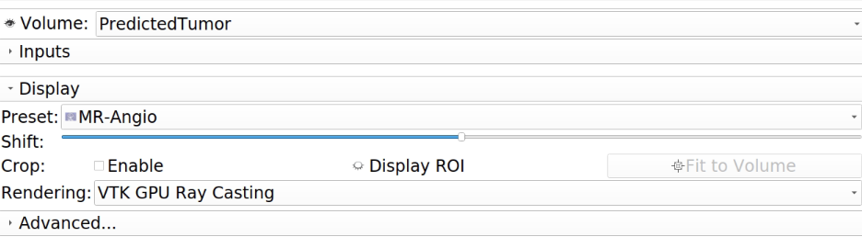
Finally, switch to the Volume Rendering module and select the following:

Slide 12
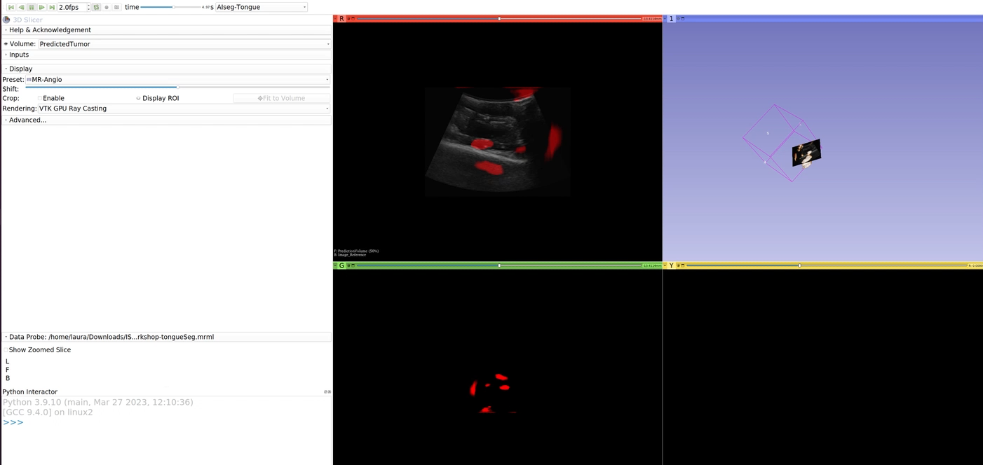
Make sure the “AISeg-tongue” sequence is playing and you should see something like this:

Slide 13
Part 2: Intro to SlicerROS2

Slide 14
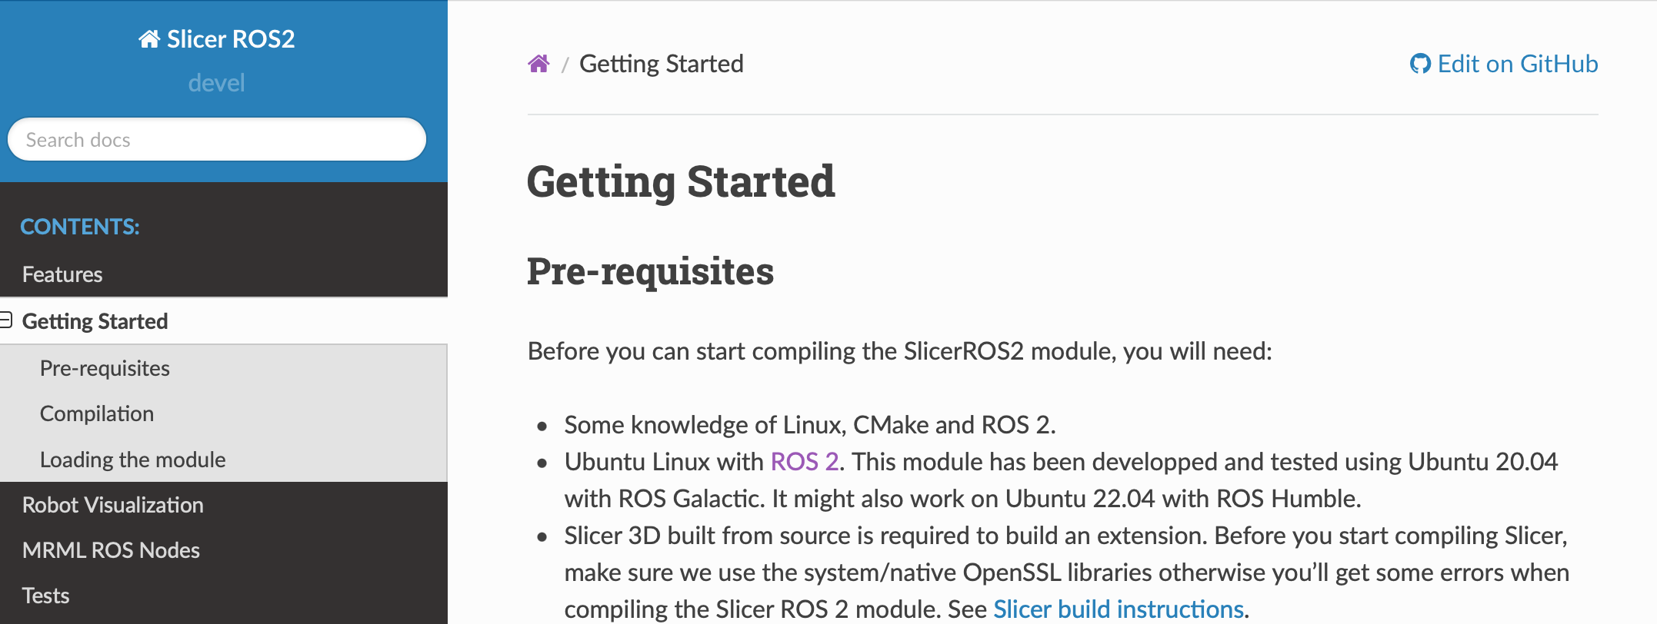
Getting started on SlicerROS2
SlicerROS2 has been built in your docker container
The instructions for installing on your own computer, and a lot of the examples we’ll go through today are available here: https://slicer-ros2.readthedocs.io/en/devel/index.html

Slide 15
How does it work?
ROS communication mechanisms are packaged as MRML nodes
3D Slicer is treated like a ROS node
Node
3D Slicer
Node
vtkMRMLROS2NodeNode
3D Slicer Node
Node
ROS side
3D Slicer side

Slide 16
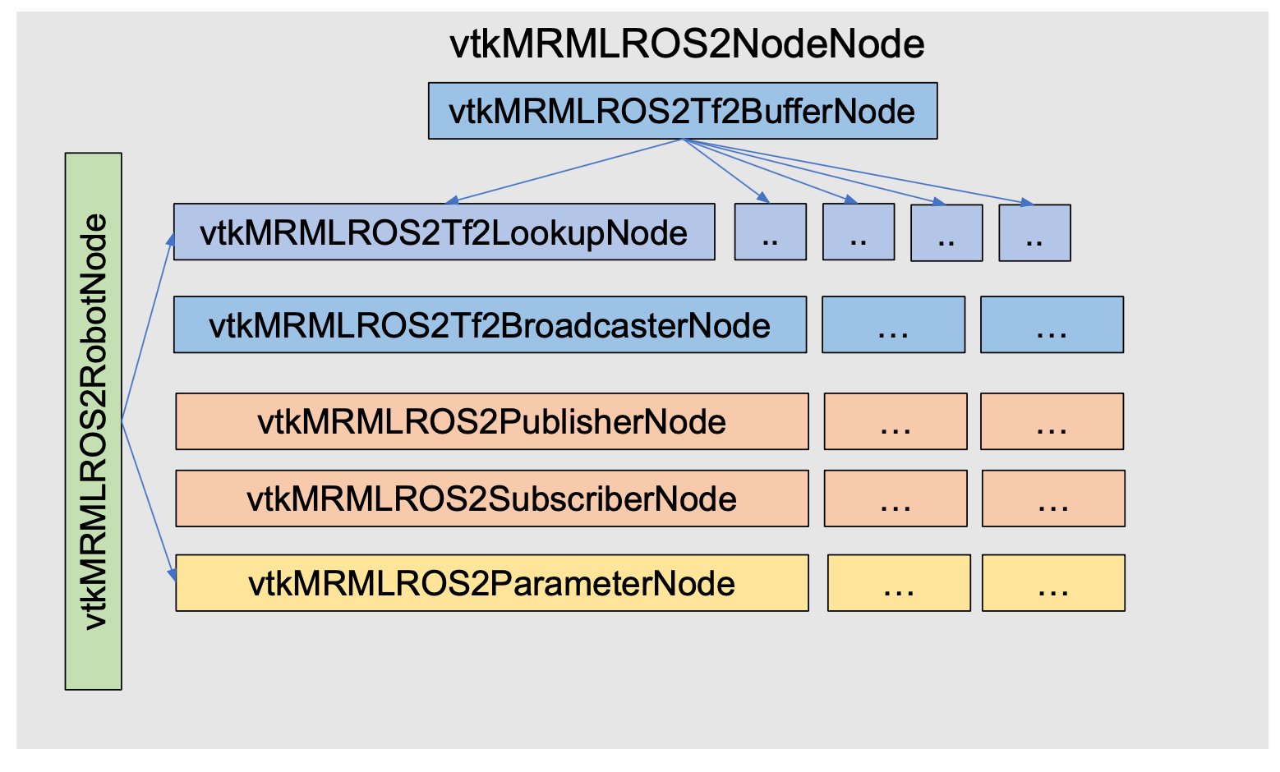
SlicerROS2 MRML nodes: Overview

Slide 17
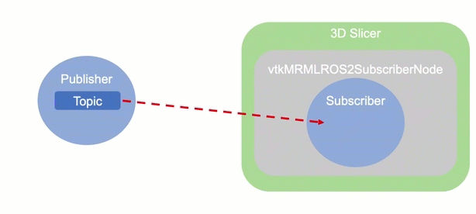
SlicerROS2 MRML nodes: Subscribers

Slide 18
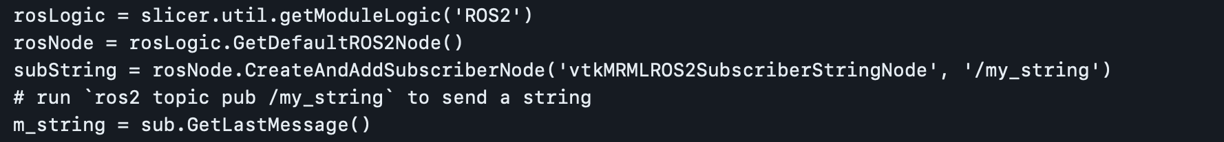
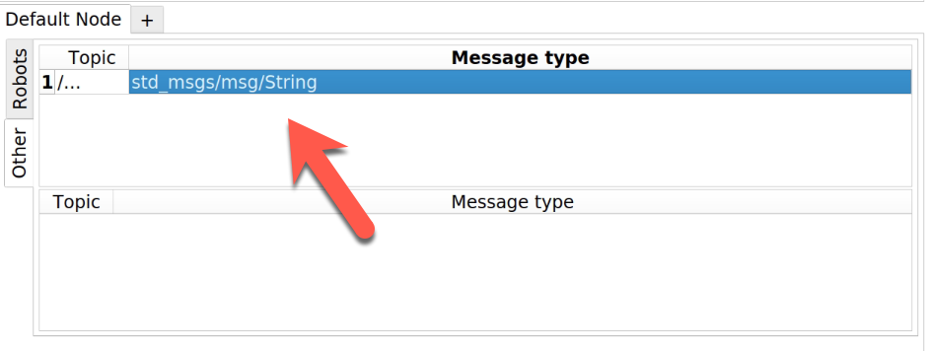
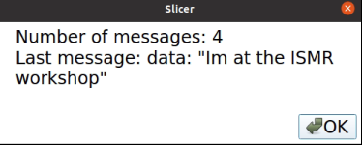
SlicerROS2 MRML nodes: Subscribers
Create your own subscriber
Notes:
You can add an observer – substring
Time stamp check for lookups in unit tests

Slide 19
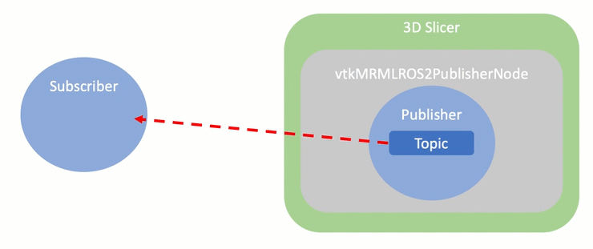
SlicerROS2 MRML nodes: Publishers

Slide 20
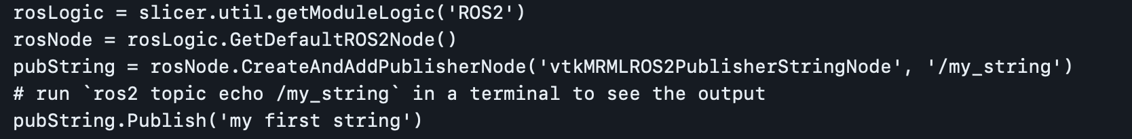
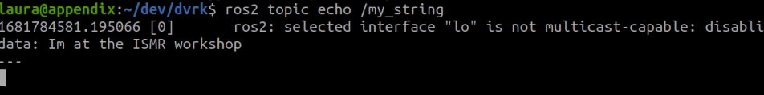
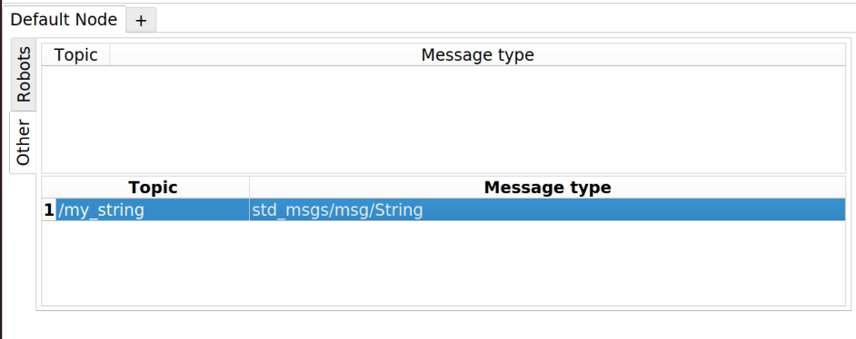
SlicerROS2 MRML nodes: Publishers
Create your own publisher

Slide 21
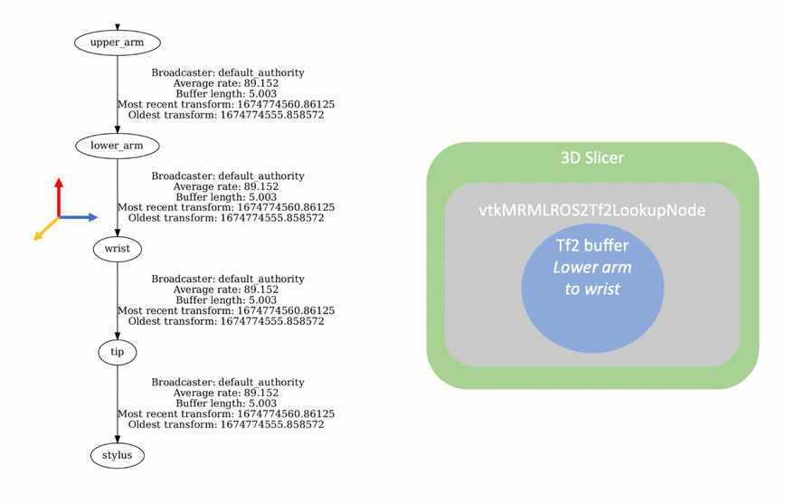
SlicerROS2 MRML nodes: Tf2 Lookup

Slide 22
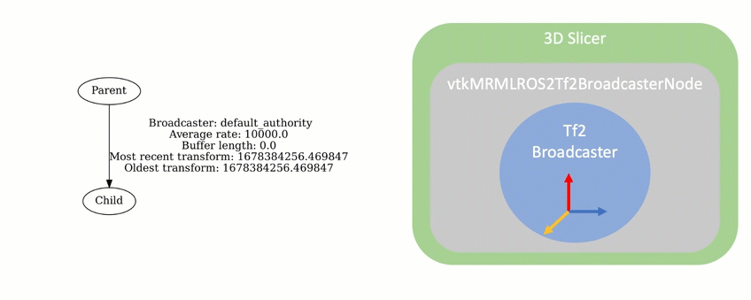
SlicerROS2 MRML nodes: Tf2 Broadcaster

Slide 23
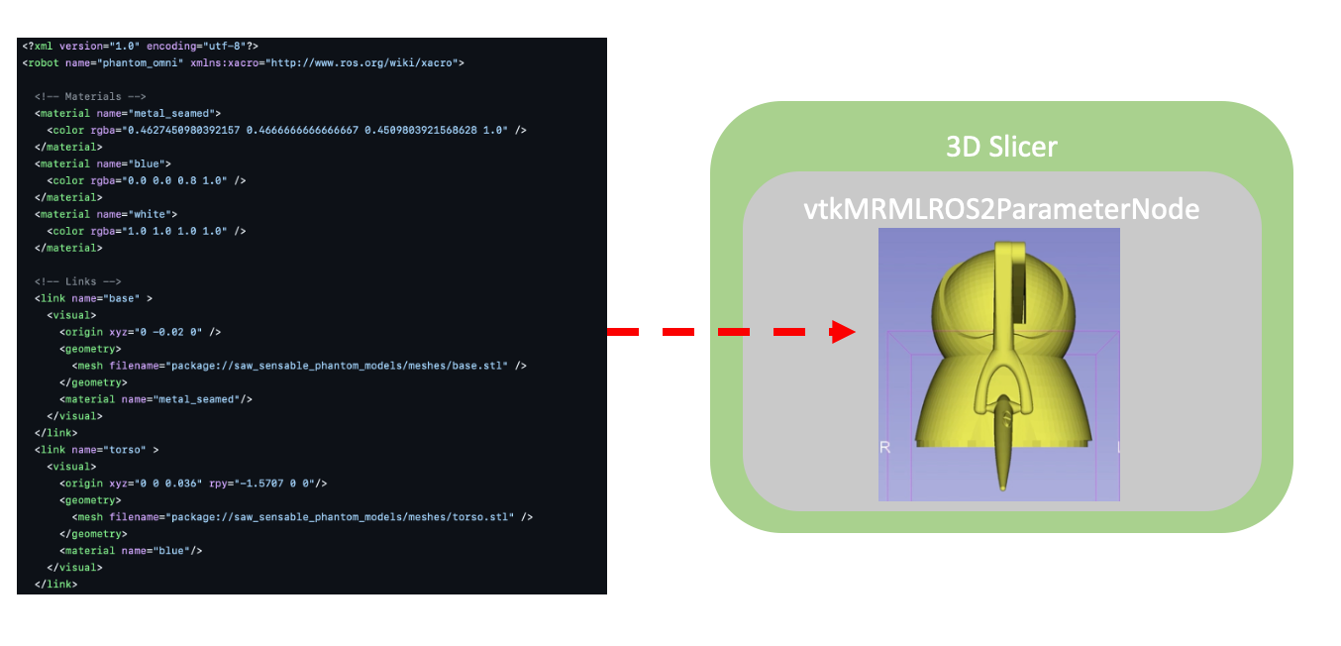
SlicerROS2 MRML nodes: Parameter

Slide 24
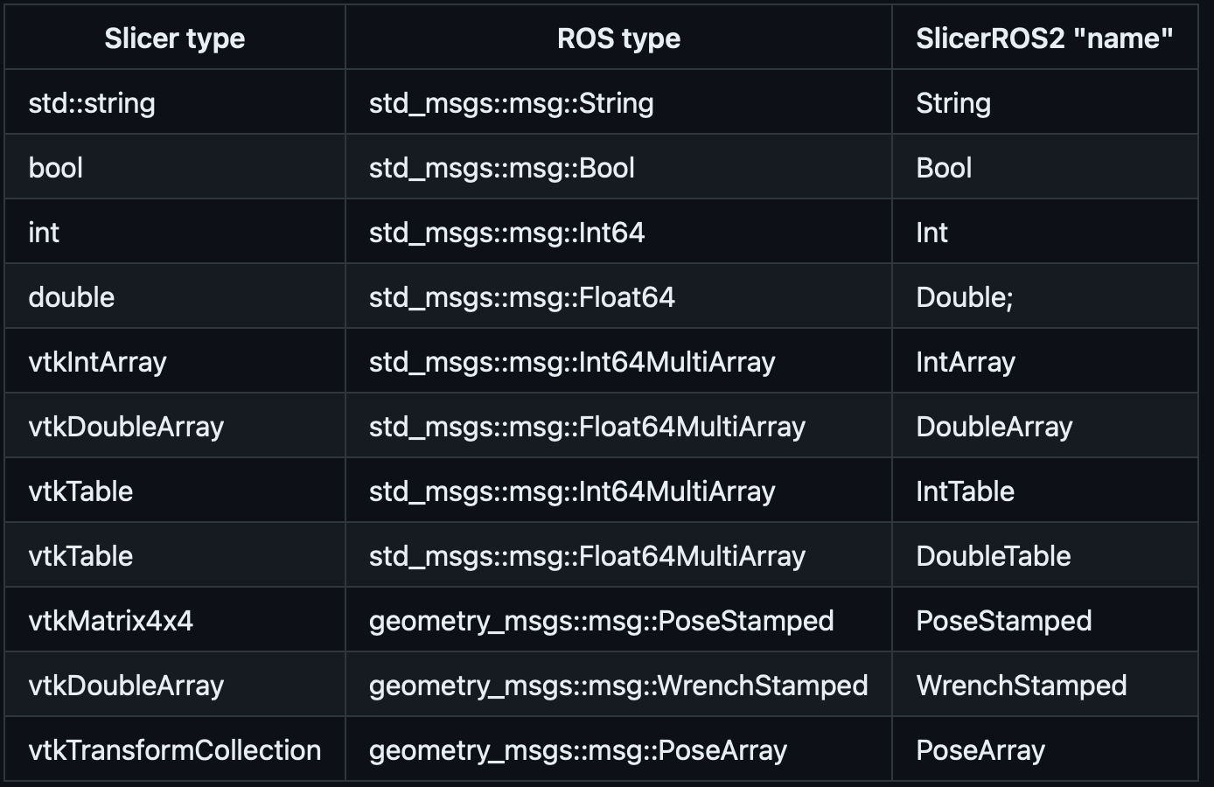
Conversion methods
We use this naming convention for publishers/ subscribers: vtkMRMLROS2PublisherxxxxNode
vtkMRMLROS2SubscriberxxxxNode
Notes:
Third column : our naming convention – String we call it in 3D Slicer
Naming convention –vtkMRMLROS2Publsiher + xxxx + Node” (xxxx) in the third column
Remove cartesian impedance gains
We added these…

Slide 25
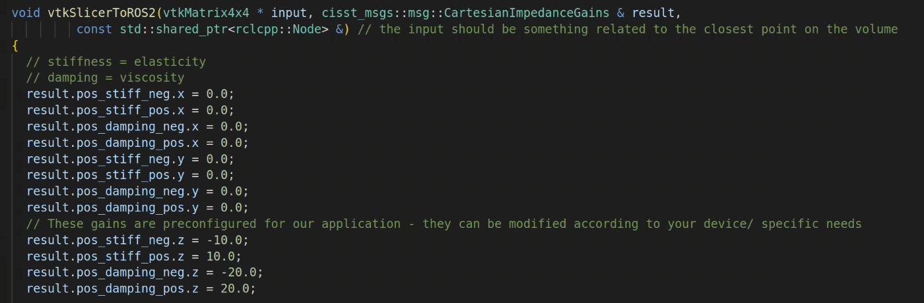
How to add your own custom publishers / subscribers:
Select a ROS type and 3D Slicer counterpart (vtk / or native C++ types) and write your conversion function:
SlicerToROS2 for publishers:
vs ROS2ToSlicer for subscribers
Initialize the new macros and register your new MRML node class:

Slide 26
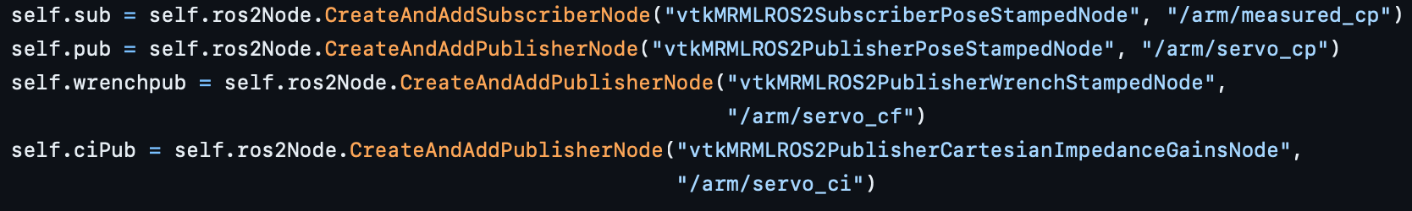
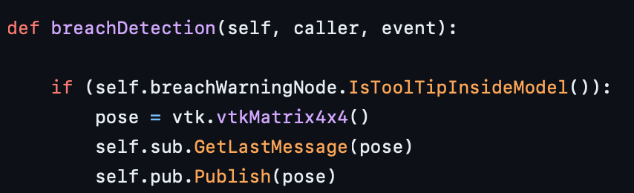
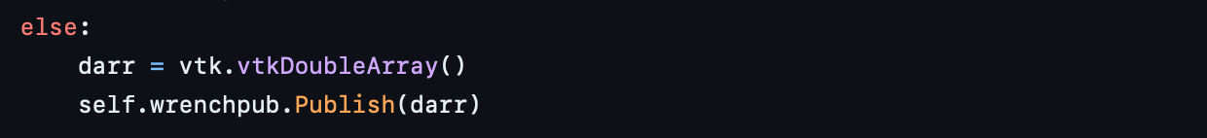
Example application: Virtual fixture
Initialize MRML objects:
Add observer:

Slide 27
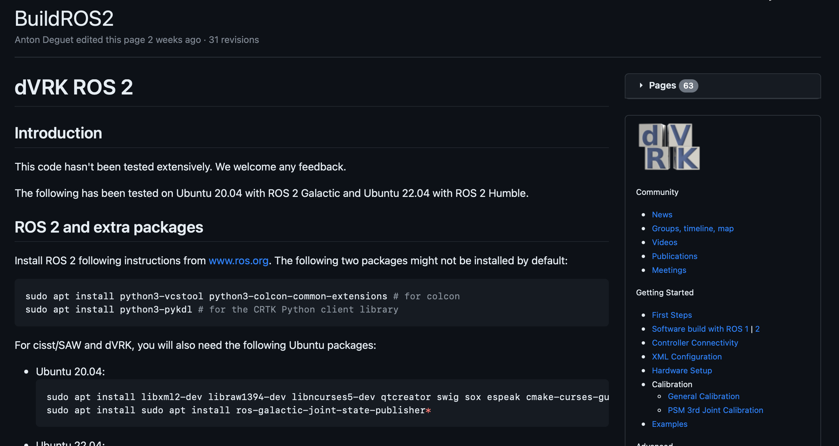
Setup the ROS2 dVRK package
Instructions found here:
https://github.com/jhu-dvrk/sawIntuitiveResearchKit/wiki/BuildROS2

Slide 28
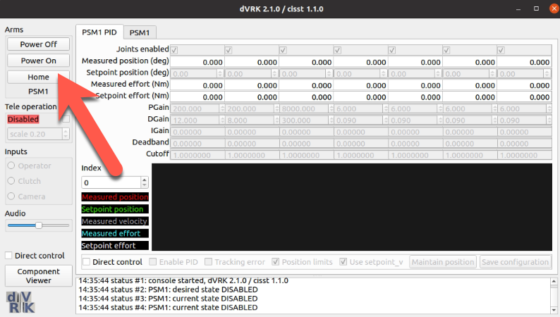
Visualize the dVRK in 3D Slicer
Launch the virtual PSM
Select “Power on”

Slide 29
Launch 3D Slicer
Start your robot state publisher:
Launch 3D Slicer from a terminal:

Slide 30
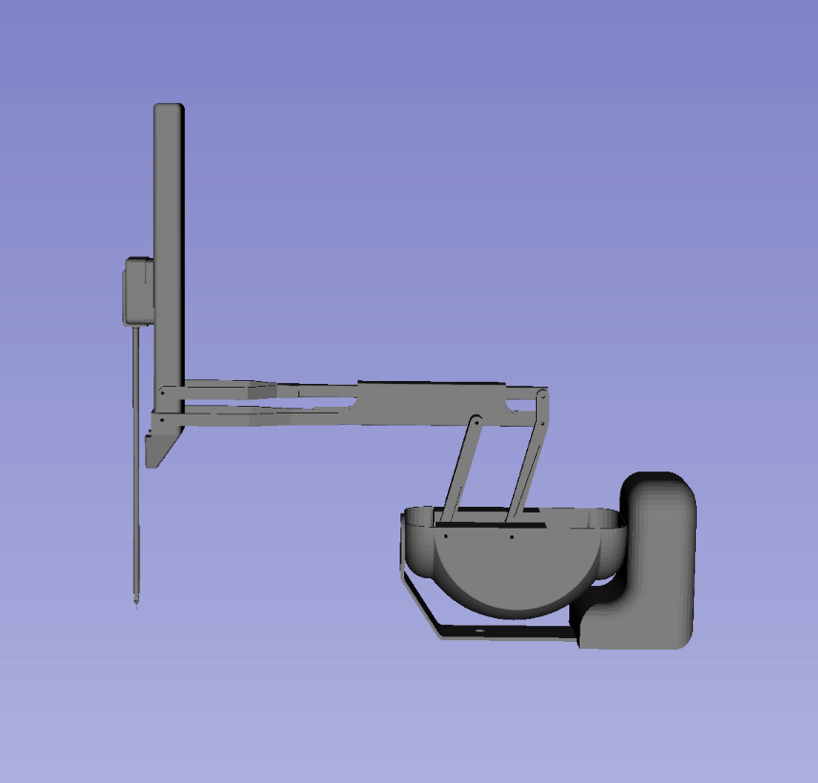
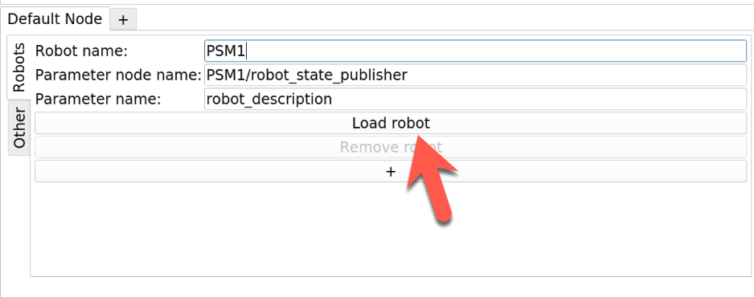
Visualize the robot
You should see this in the 3D viewer:
Set up the names correctly:
You may need to zoom out to see this! Scroll towards you on your mouse to do so

Slide 31
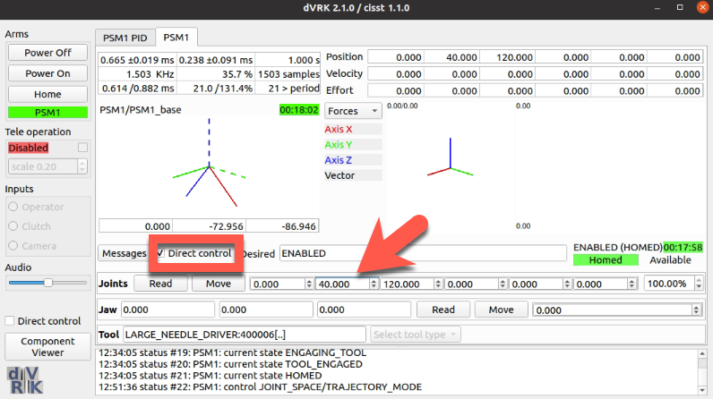
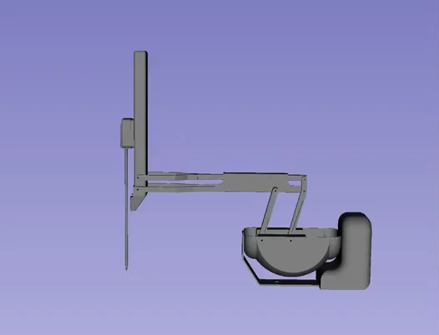
Move the robot
Direct control:
Or you can use this script:
Notes:
Run the dVRK – test script from read the doc (make the robot move)

Slide 32
Part 3: Image registration and path planning in Slicer

Slide 33
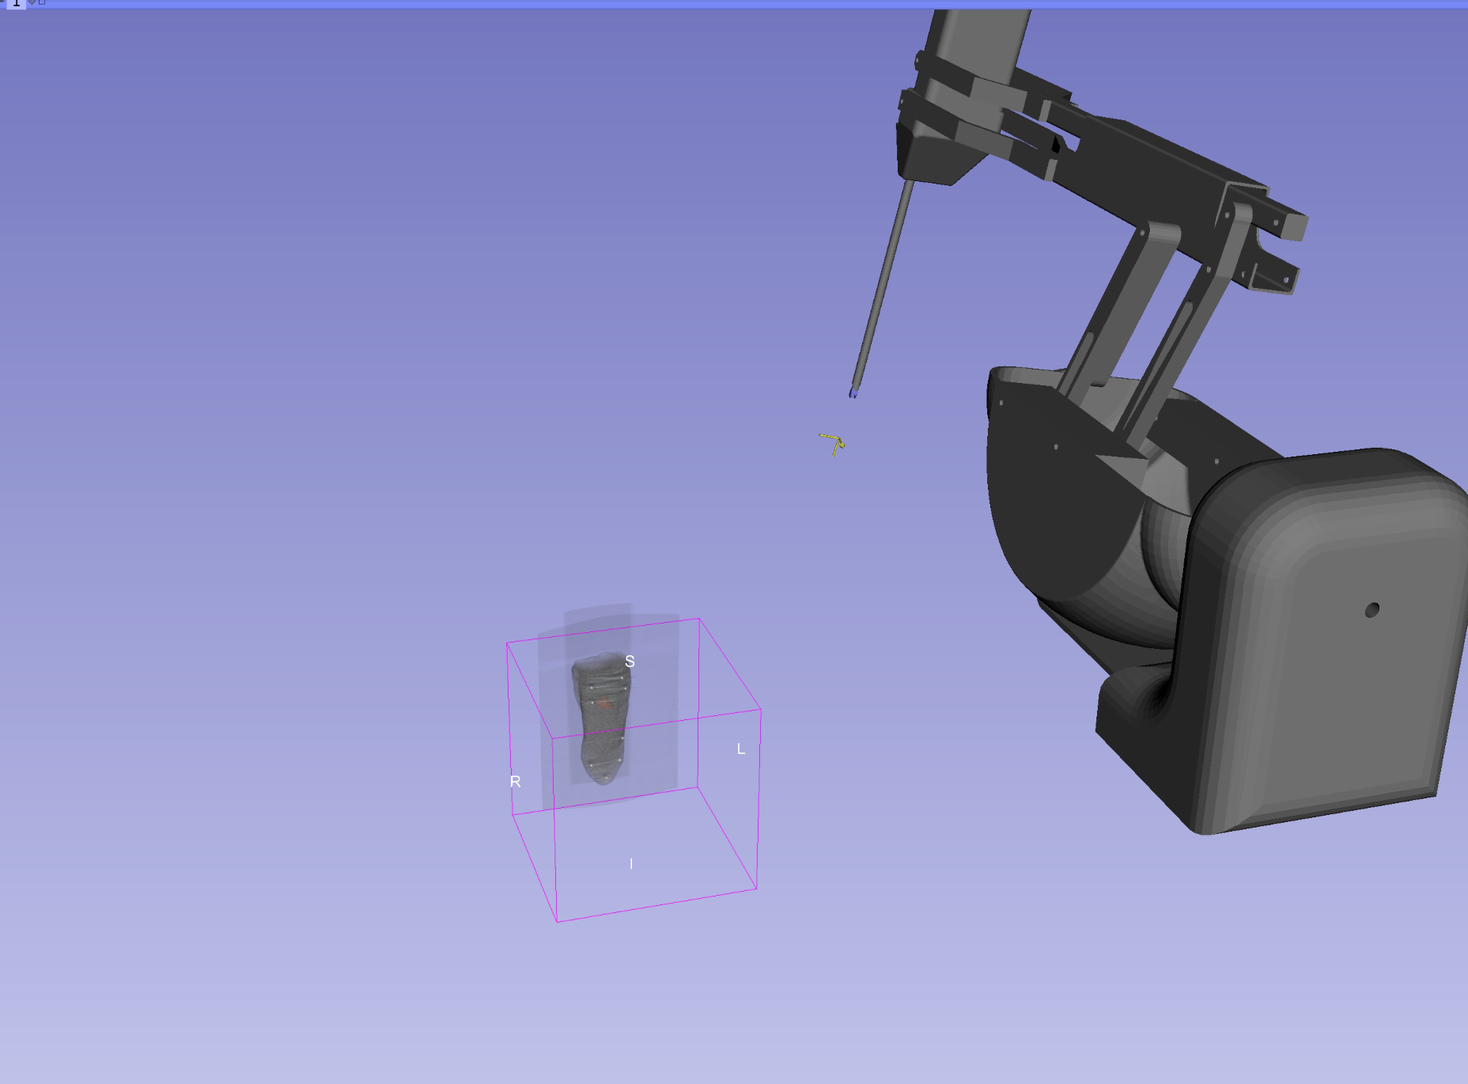
Load the scene into 3D Slicer
Drag and drop the scene called “RegisteredScene-dVRKToTongue.mrb” into 3D Slicer
You should see something like this:
Notes:
Make sure to relaunch Slicer – start with a new scene

Slide 34
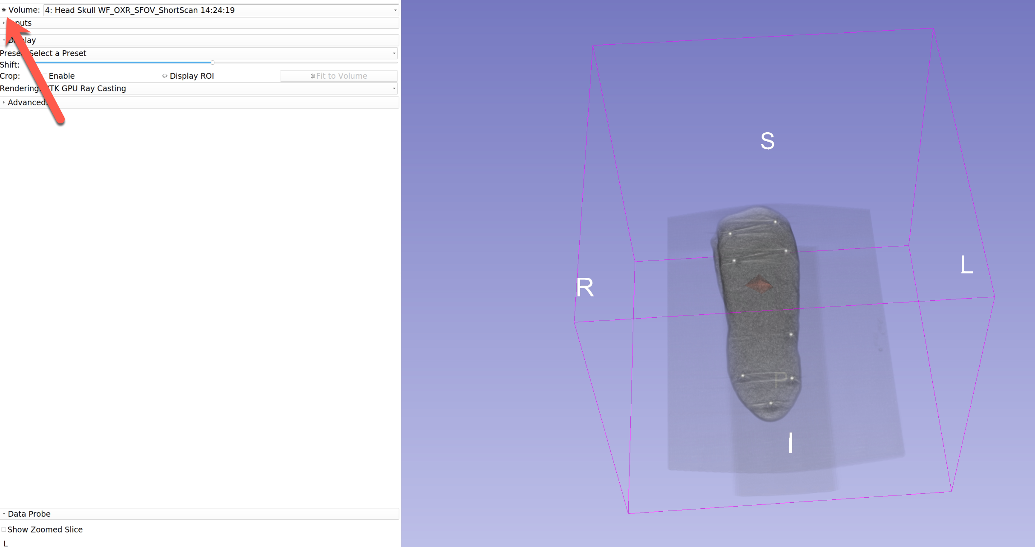
Get Familiar with the scene
Switch to the Volume Rendering module and press the eyeball on the top left to hide and show the tumor in the tongue

Slide 35
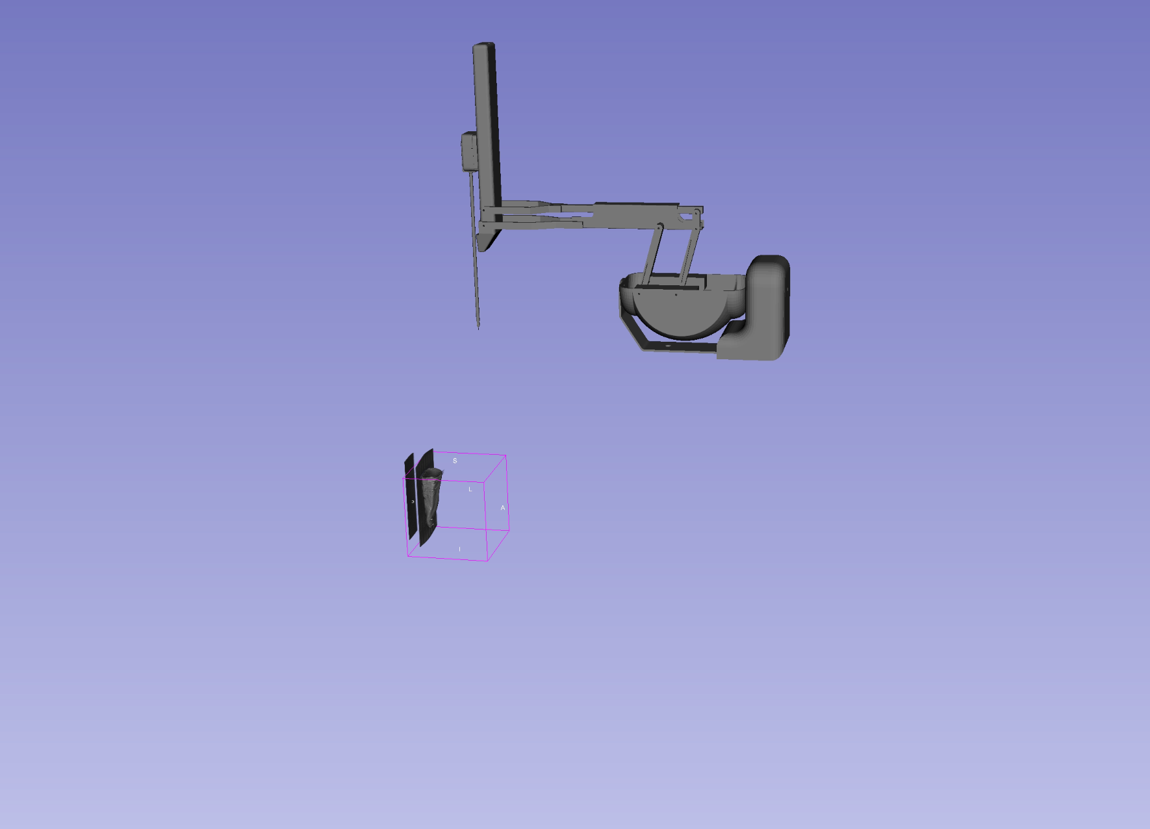
The image and the robot are not in the same coordinate system yet

Slide 36
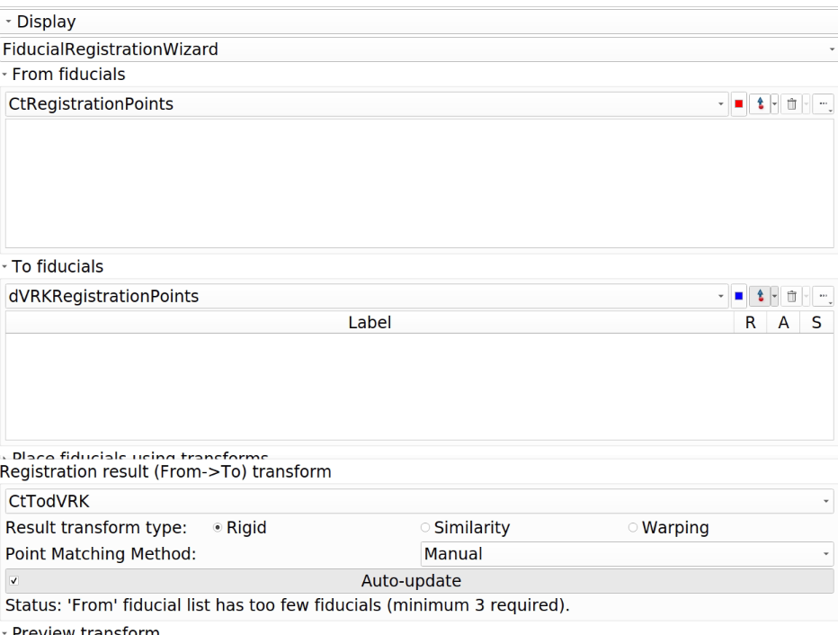
**We’ve already done this for you
3. Switch to the Fiducial Registration Wizard module and create:
CT registration points
dVRK registration points
CtTodVRK

Slide 37
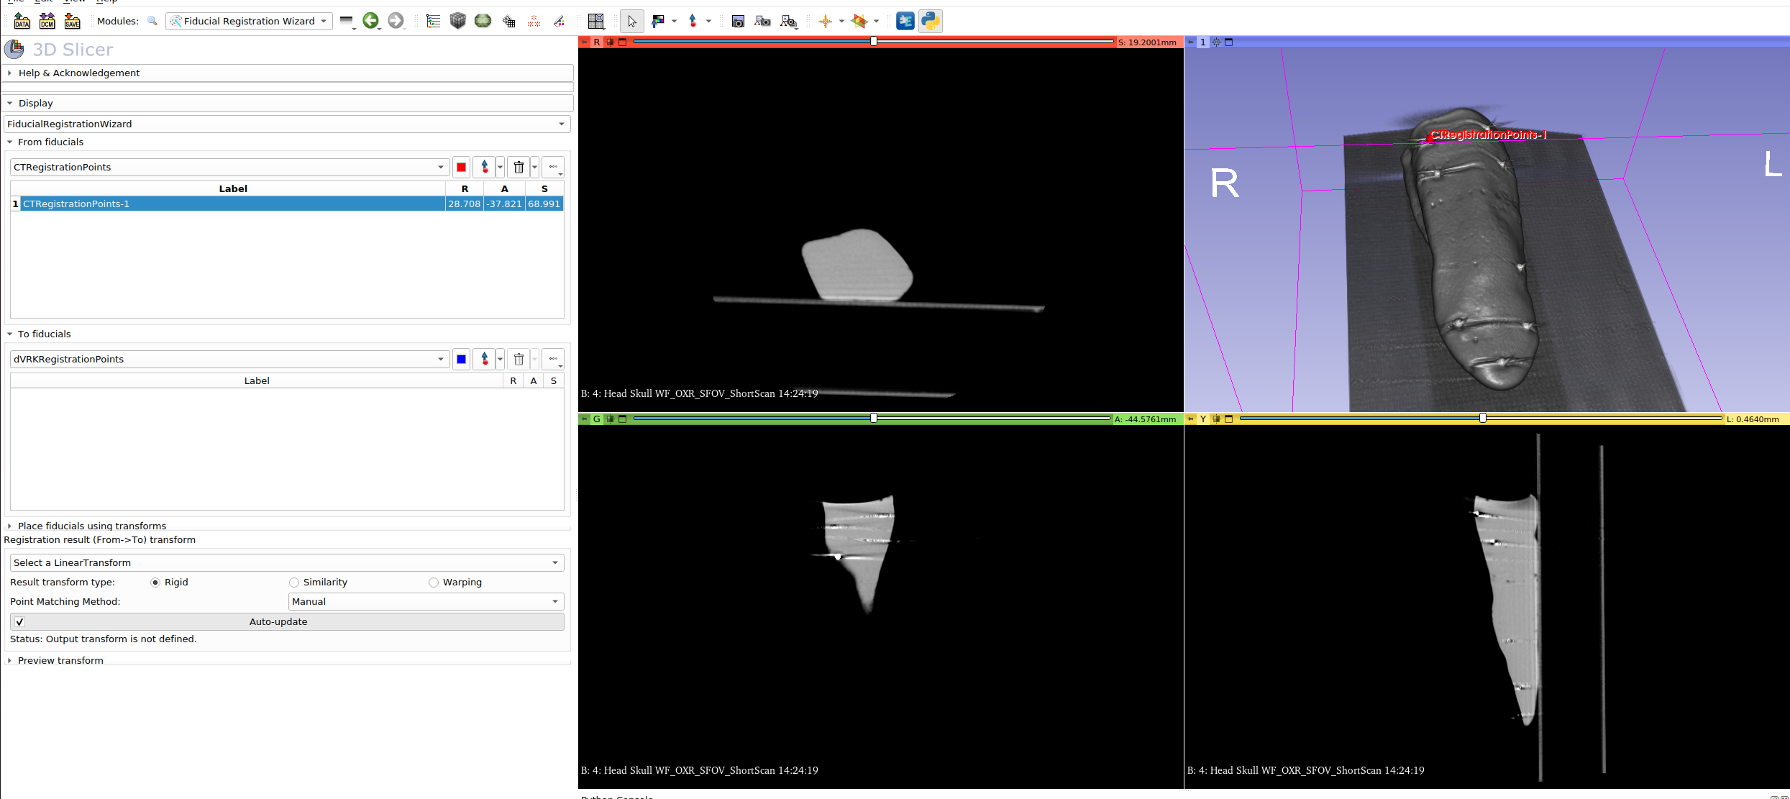
Place a fiducial on the CT bead in the volume rendering using the 3D viewer

Slide 38
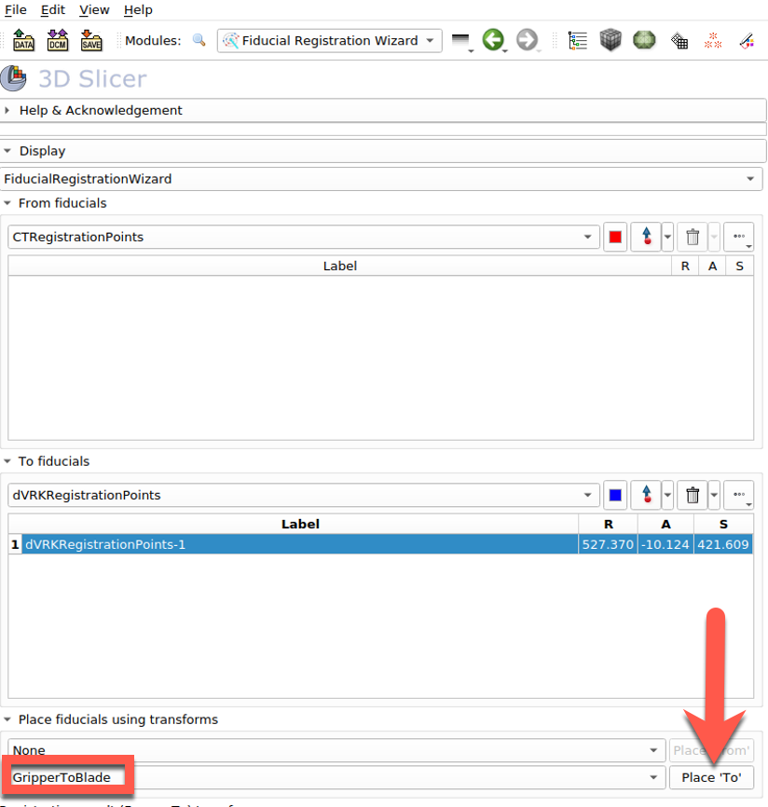
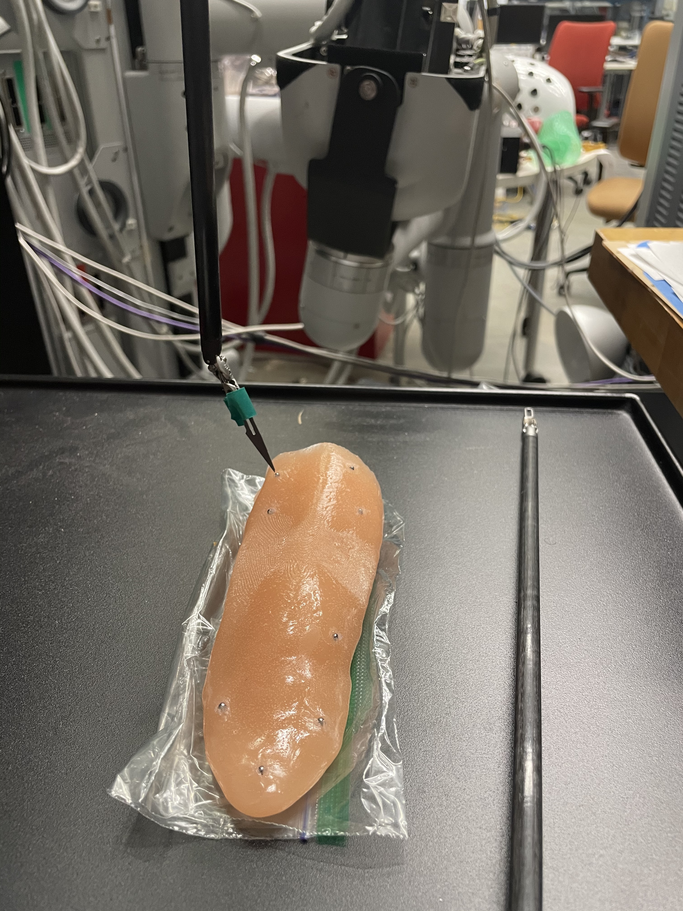
GripperToBlade is a transform that we append to the tree to access the position of the tip of the blade
Move the robot to the same point and press:
Place ‘To’
Repeat this for all the points! Make sure the order of points matches

Slide 39
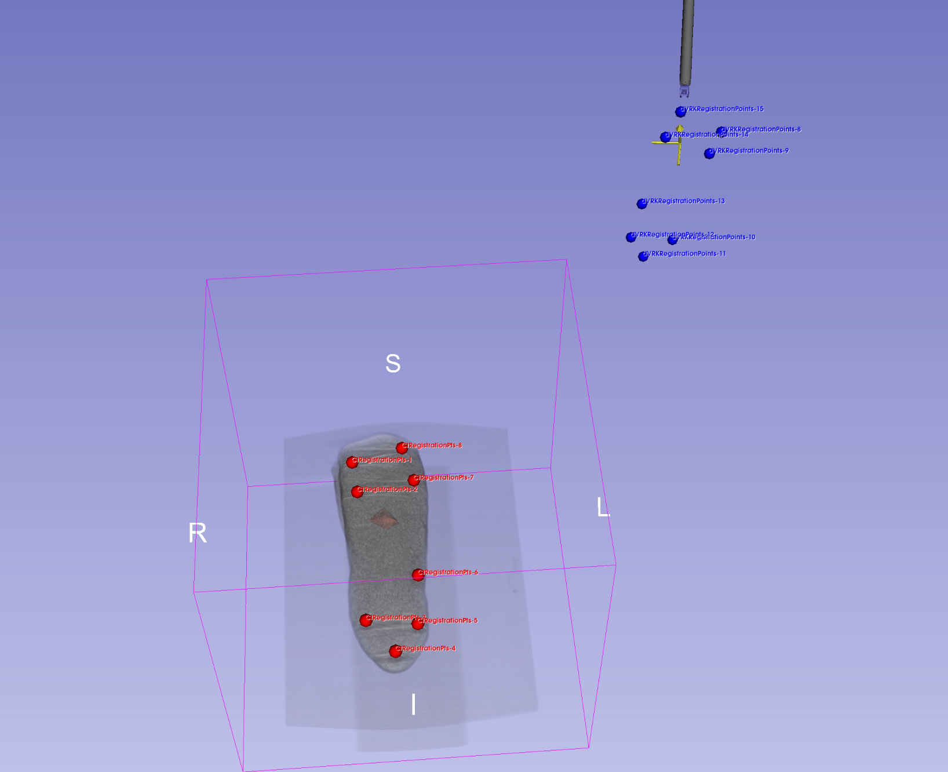
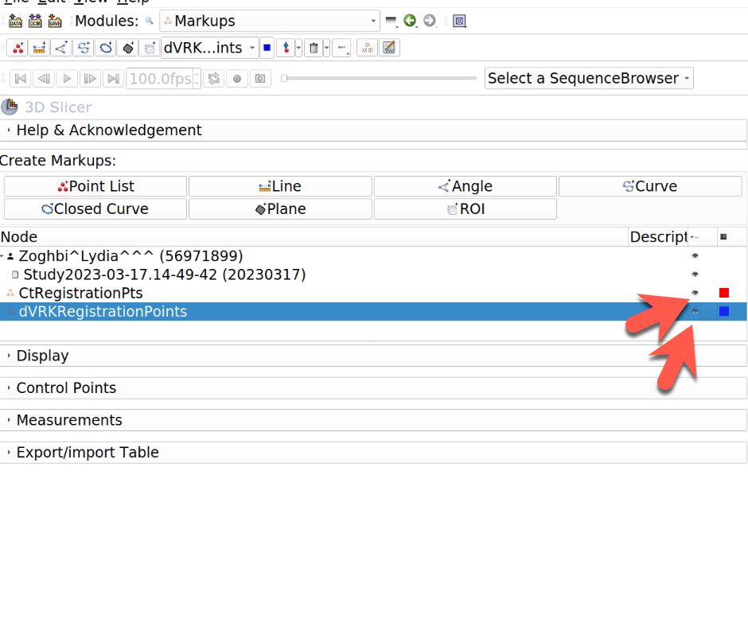
4. Switch to the Markups module to visualize these points

Slide 40
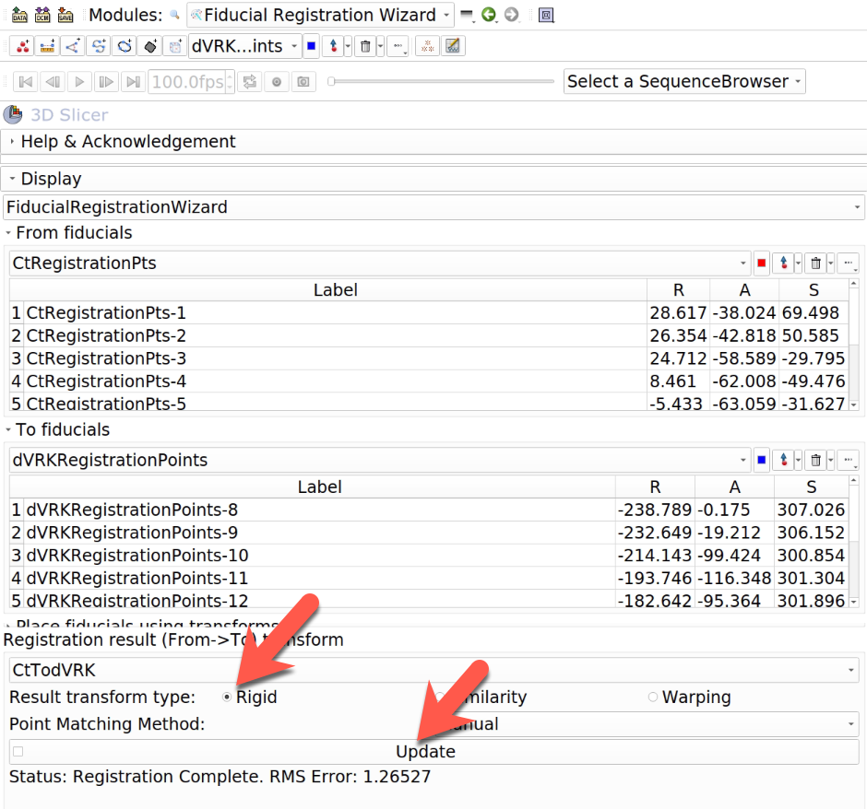
5. Switch back to Fiducial Registration Wizard and update the transform

Slide 41
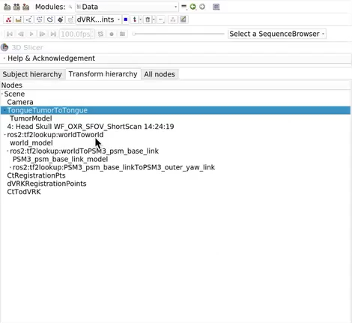
6. Switch to the Data module and move the Ct image and the tumor under this new transformation

Slide 42
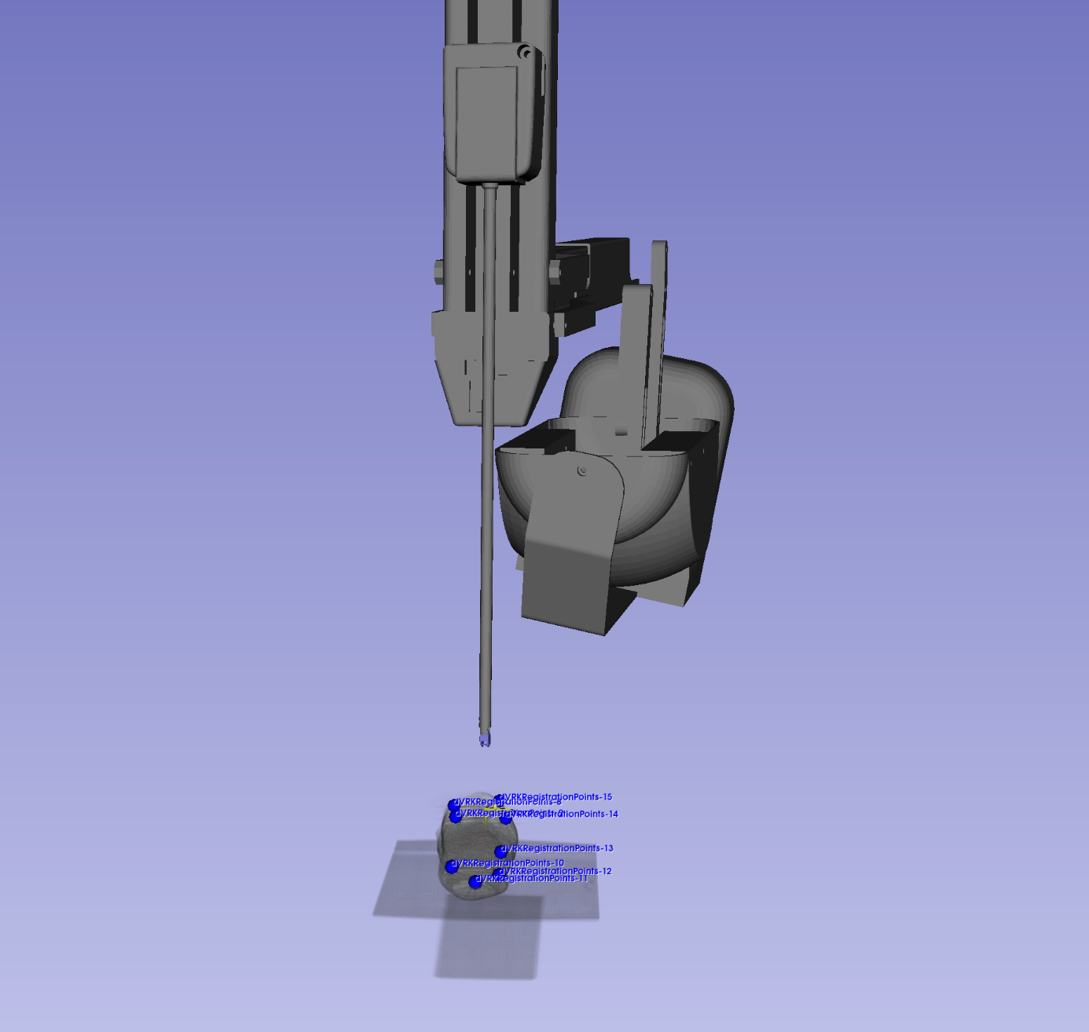
Now we’re registered!

